Slide 1
Chapter 9:
Database Systems
Computer Science: An Overview
Eleventh Edition
by
J. Glenn Brookshear

Slide 2
Chapter 9: Database Systems
9.1 Database Fundamentals
9.2 The Relational Model
9.3 Object-Oriented Databases
9.4 Maintaining Database Integrity
9.5 Traditional File Structures
9.6 Data Mining
9.7 Social Impact of Database Technology
0-<number>

Slide 3
Database
A collection of data that is multidimensional in the sense that internal links between its entries make the information accessible from a variety of perspectives
0-<number>

Slide 4
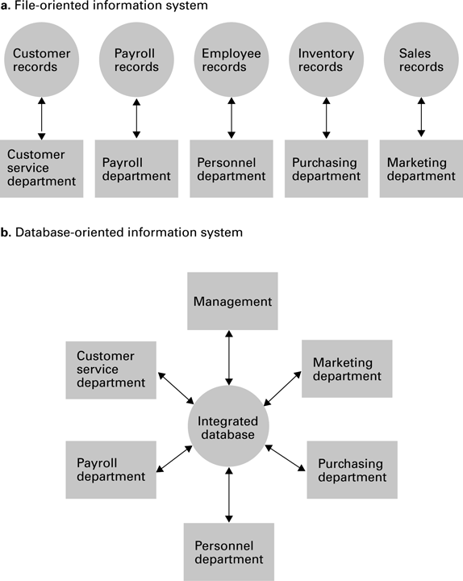
Figure 9.1 A file versus a database organization
0-<number>

Slide 5
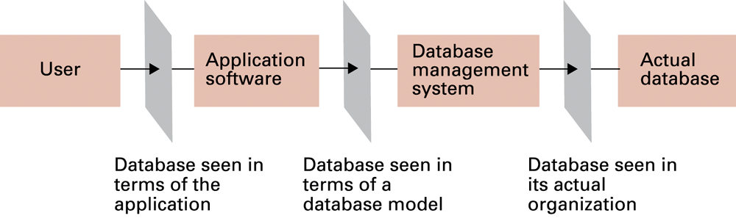
Figure 9.2 The conceptual layers of a database implementation
0-<number>

Slide 6
Schemas
Schema: A description of the structure of an entire database, used by database software to maintain the database
Subschema: A description of only that portion of the database pertinent to a particular user’s needs, used to prevent sensitive data from being accessed by unauthorized personnel
0-<number>

Slide 7
Database Management Systems
Database Management System (DBMS): A software layer that manipulates a database in response to requests from applications
Distributed Database: A database stored on multiple machines
  DBMS will mask this organizational detail from its users
Data independence: The ability to change the organization of a database without changing the application software that uses it
0-<number>

Slide 8
Database Models
Database model: A conceptual view of a database
  Relational database model
  Object-oriented database model
0-<number>

Slide 9
Relational Database Model
Relation: A rectangular table
  Attribute: A column in the table
  Tuple: A row in the table
0-<number>

Slide 10
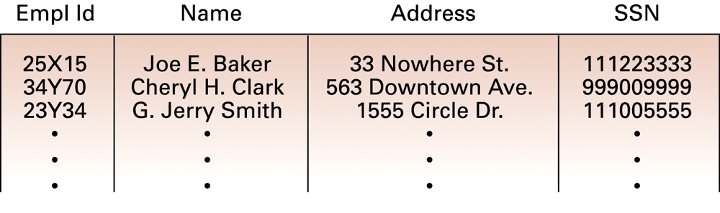
Figure 9.3 A relation containing employee information
0-<number>

Slide 11
Relational Design
Avoid multiple concepts within one relation
  Can lead to redundant data
  Deleting a tuple could also delete necessary but unrelated information
0-<number>

Slide 12
Improving a Relational Design
Decomposition: Dividing the columns of a relation into two or more relations, duplicating those columns necessary to maintain relationships
  Lossless or nonloss decomposition: A “correct” decomposition that does not lose any information
0-<number>

Slide 13
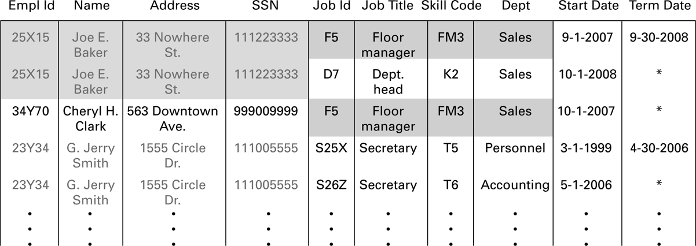
Figure 9.4 A relation containing redundancy
0-<number>

Slide 14
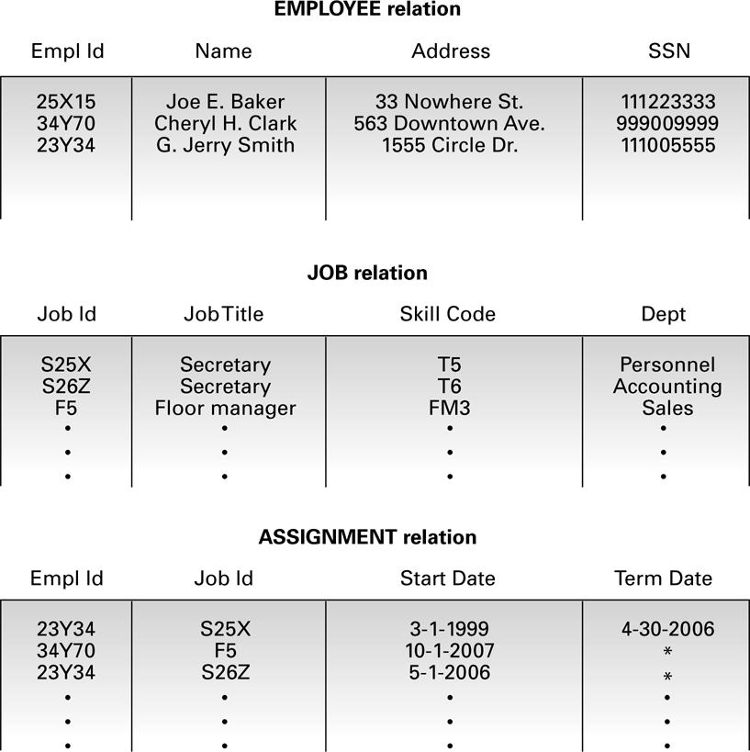
Figure 9.5 An employee database consisting of three relations
0-<number>

Slide 15
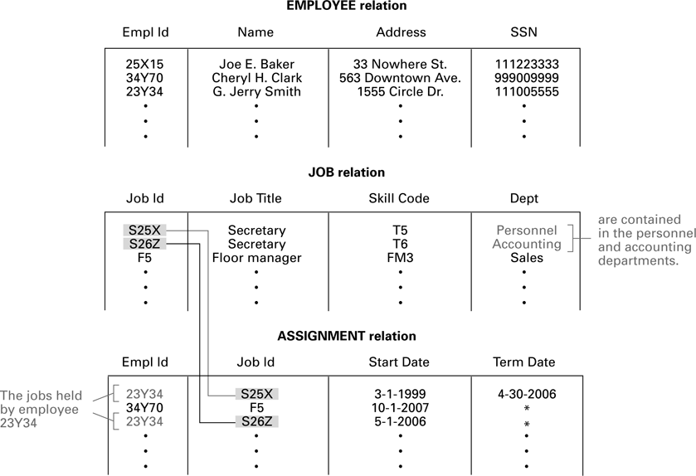
Figure 9.6 Finding the departments in which employee 23Y34 has worked
0-<number>

Slide 16
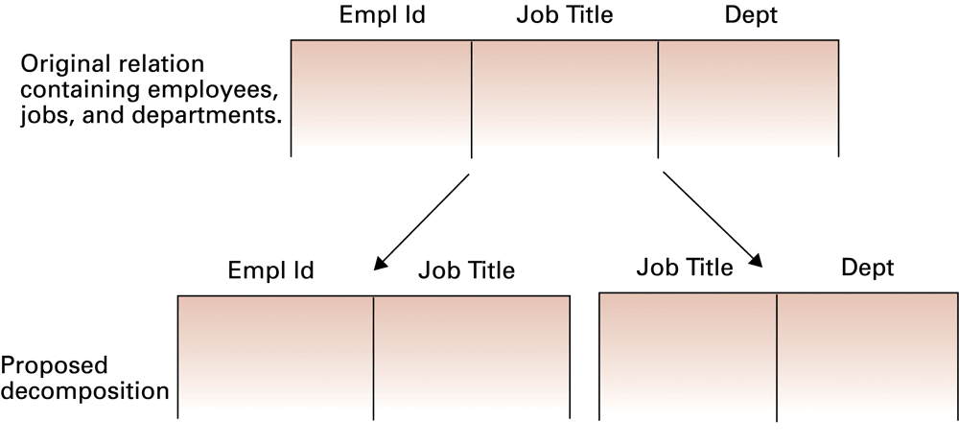
Figure 9.7 A relation and a proposed decomposition
0-<number>

Slide 17
Relational Operations
Select: Choose rows
Project: Choose columns
Join: Assemble information from two or more relations
0-<number>

Slide 18
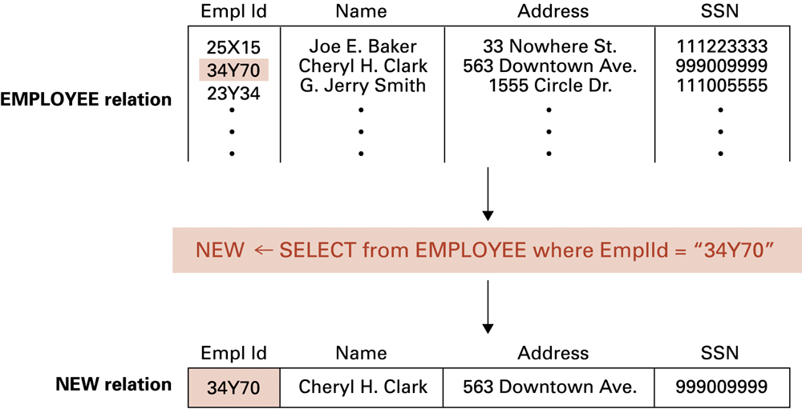
Figure 9.8 The SELECT operation
0-<number>

Slide 19
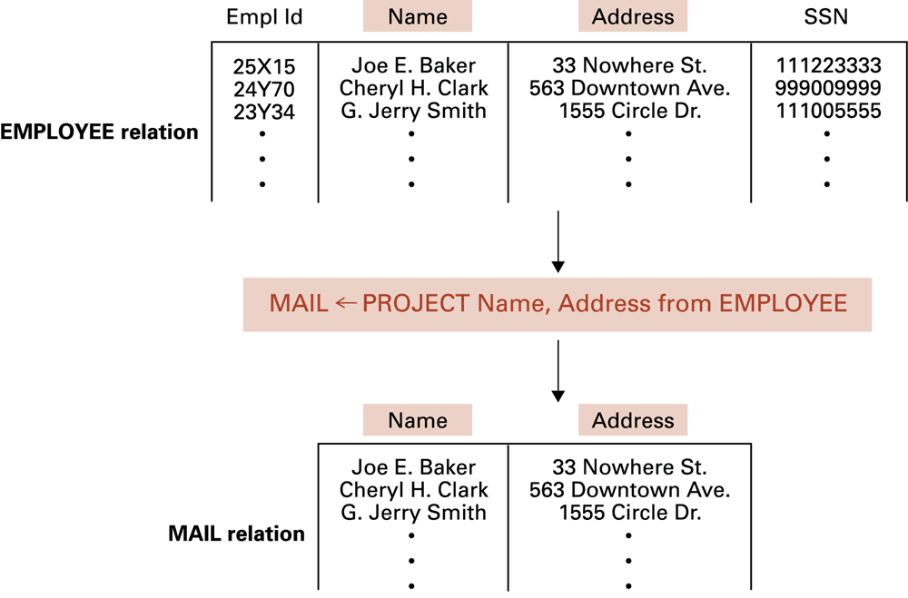
Figure 9.9 The PROJECT operation
0-<number>

Slide 20
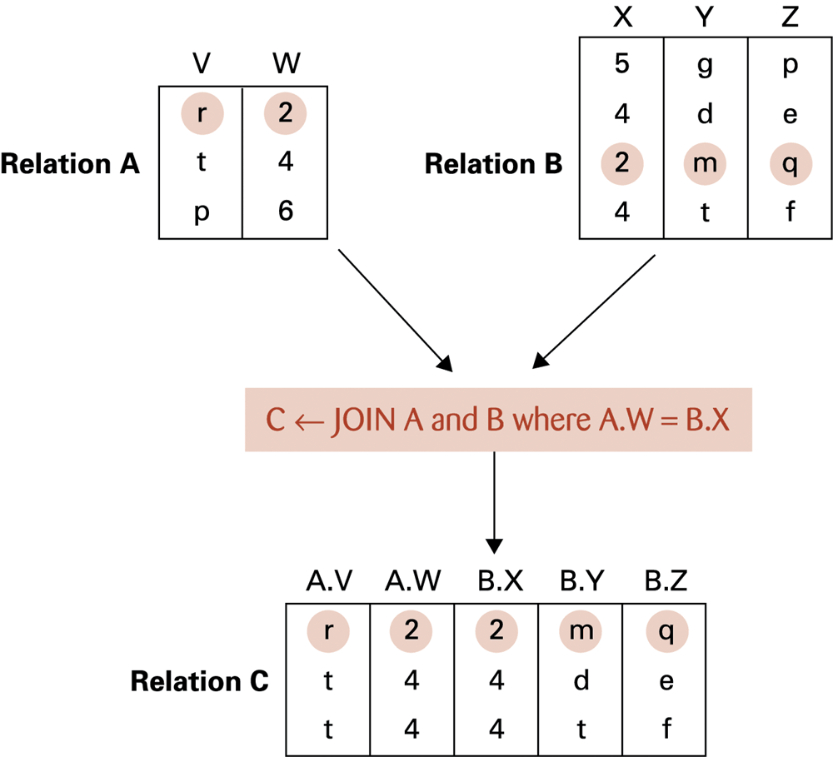
Figure 9.10 The JOIN operation
0-<number>

Slide 21
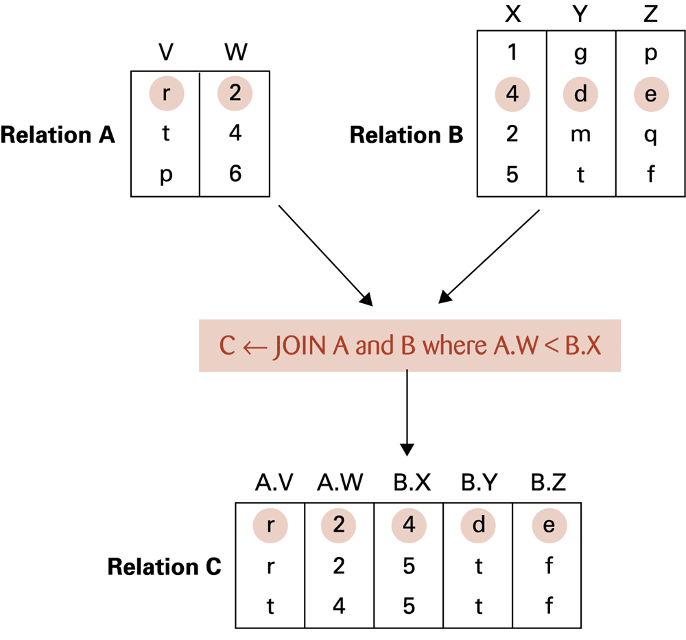
Figure 9.11 Another example of the JOIN operation
0-<number>

Slide 22
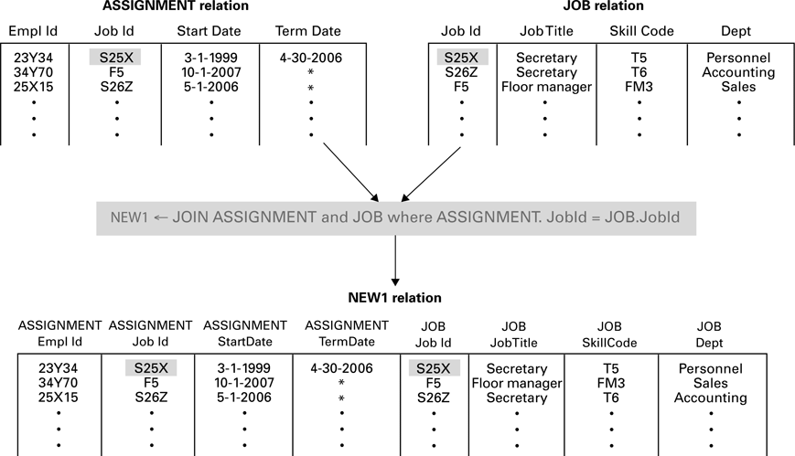
Figure 9.12 An application of the JOIN operation
0-<number>

Slide 23
Structured Query Language (SQL)
Operations to manipulate tuples
  insert
  update
  delete
  select
0-<number>

Slide 24
SQL Examples
select EmplId, Dept
from ASSIGNMENT, JOB
where ASSIGNMENT.JobId = JOB.JobId
and ASSIGNMENT.TermData = “*”
insert into EMPLOYEE
values (‘43212’, ‘Sue A. Burt’,
’33 Fair St.’, ‘444661111’)
0-<number>

Slide 25
SQL Examples (continued)
delete from EMPLOYEE
where Name = ‘G. Jerry Smith’
update EMPLOYEE
set Address = ‘1812 Napoleon Ave.’
where Name = ‘Joe E. Baker’
0-<number>

Slide 26
Object-oriented Databases
Object-oriented Database: A database constructed by applying the object-oriented paradigm
  Each entity stored as a persistent object
  Relationships indicated by links between objects
  DBMS maintains inter-object links
0-<number>

Slide 27
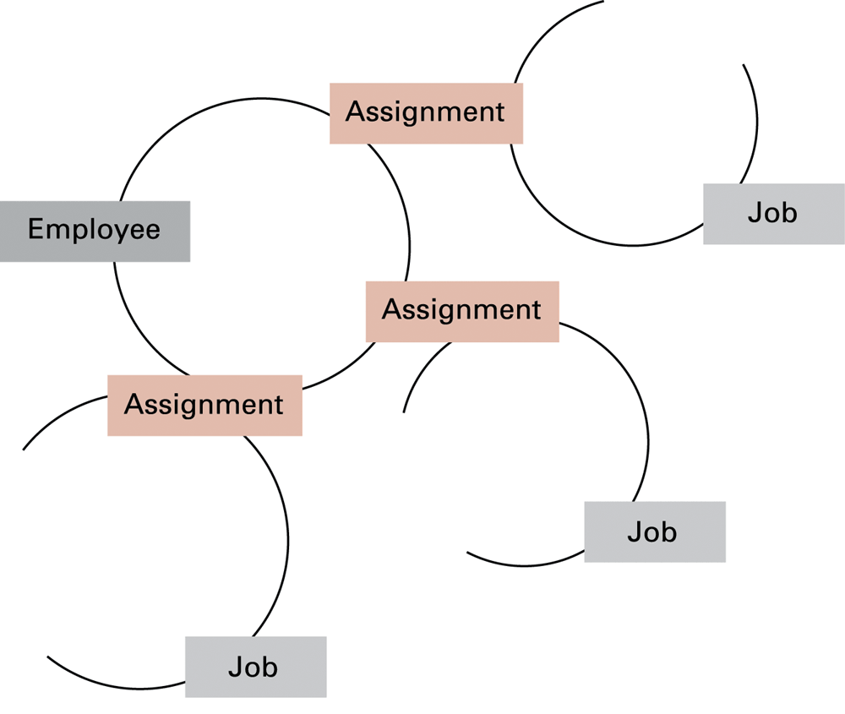
Figure 9.13 The associations between objects in an object-oriented database
0-<number>

Slide 28
Advantages of Object-oriented Databases
Matches design paradigm of object-oriented applications
Intelligence can be built into attribute handlers
Can handle exotic data types
  Example: multimedia
0-<number>

Slide 29
Maintaining Database Integrity
Transaction: A sequence of operations that must all happen together
  Example: transferring money between bank accounts
Transaction log: A non-volatile record of each transaction’s activities, built before the transaction is allowed to execute
  Commit point: The point at which a transaction has been recorded in the log
  Roll-back: The process of undoing a transaction
0-<number>

Slide 30
Maintaining database integrity (continued)
Simultaneous access problems
  Incorrect summary problem
  Lost update problem
Locking = preventing others from accessing data being used by a transaction
  Shared lock: used when reading data
  Exclusive lock: used when altering data
0-<number>

Slide 31
Sequential Files
Sequential file: A file whose contents can only be read in order
  Reader must be able to detect end-of-file (EOF)
  Data can be stored in logical records, sorted by a key field
    Greatly increases the speed of batch updates
0-<number>

Slide 32
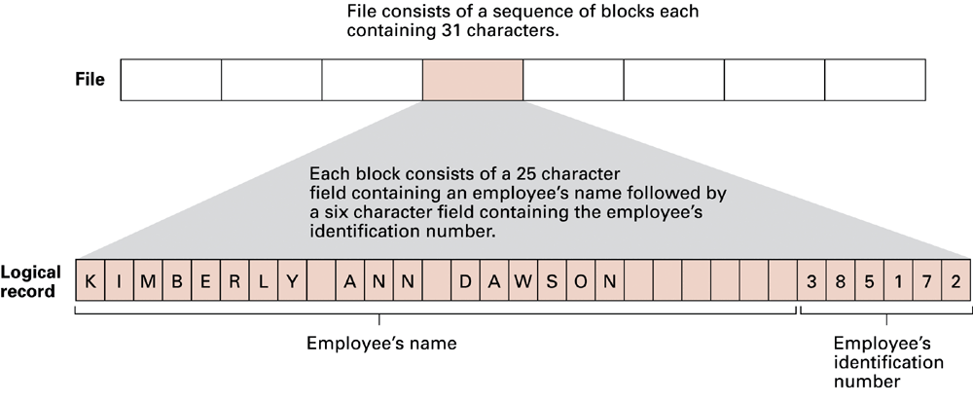
Figure 9.14 The structure of a simple employee file implemented as a text file
0-<number>

Slide 33
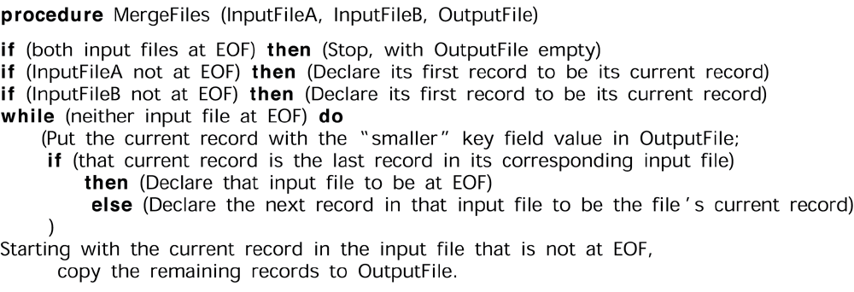
Figure 9.15 A procedure for merging two sequential files
0-<number>

Slide 34
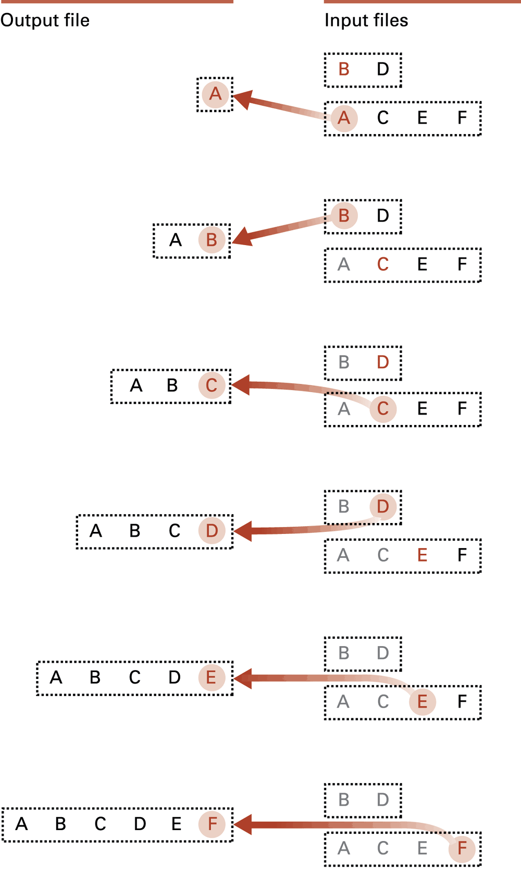
Figure 9.16
Applying the merge algorithm (Letters are used to represent entire records.
The particular letter indicates the value of the record’s key field.)

Slide 35
Indexed Files
Index: A list of key values and the location of their associated records
0-<number>

Slide 36
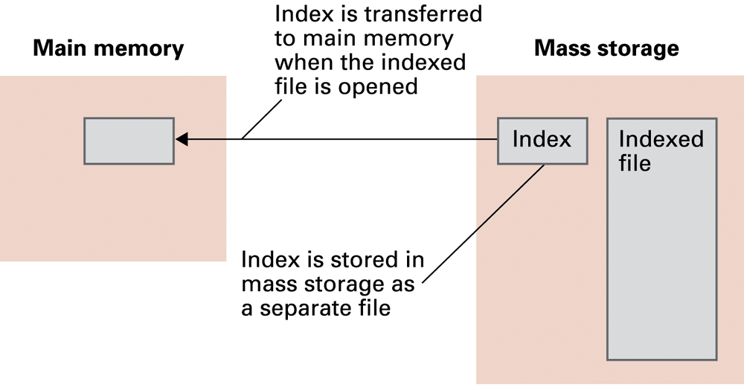
Figure 9.17 Opening an indexed file
0-<number>

Slide 37
Hashing
Each record has a key field
The storage space is divided into buckets
A hash function computes a bucket number for each key value
Each record is stored in the bucket corresponding to the hash of its key
0-<number>

Slide 38
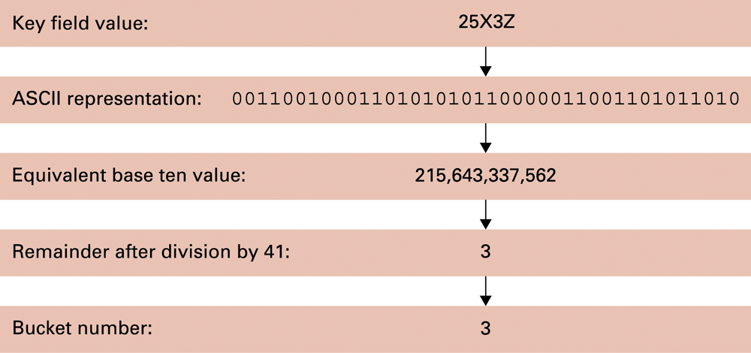
Figure 9.18 Hashing the key field value 25X3Z to one of 41 buckets
0-<number>

Slide 39
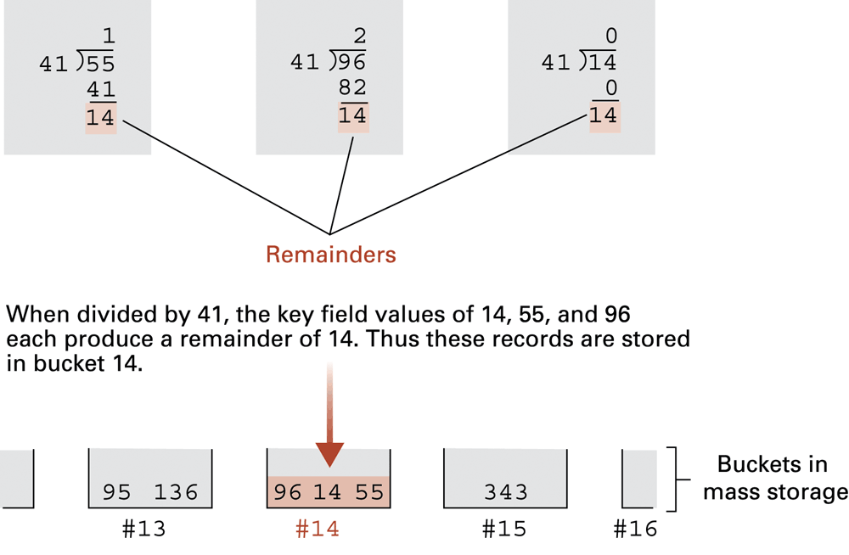
Figure 9.19 The rudiments of a hashing system
0-<number>

Slide 40
Collisions in Hashing
Collision: The case of two keys hashing to the same bucket
  Major problem when table is over 75% full
  Solution: increase number of buckets and rehash all data
0-<number>

Slide 41
Data Mining
Data Mining: The area of computer science that deals with discovering patterns in collections of data
Data warehouse: A static data collection to be mined
  Data cube: Data presented from many perspectives to enable mining
0-<number>

Slide 42
Data Mining Strategies
Class description
Class discrimination
Cluster analysis
Association analysis
Outlier analysis
Sequential pattern analysis
0-<number>

Slide 43
Social Impact of Database Technology
Problems
  Massive amounts of personal data are being collected
    Often without knowledge or meaningful consent of affected people
  Data merging produces new, more invasive information
  Errors are widely disseminated and hard to correct
Remedies
  Existing legal remedies often difficult to apply
  Negative publicity may be more effective
0-<number>

